Slide 1
6.2 Early Phases of the War

Slide 2
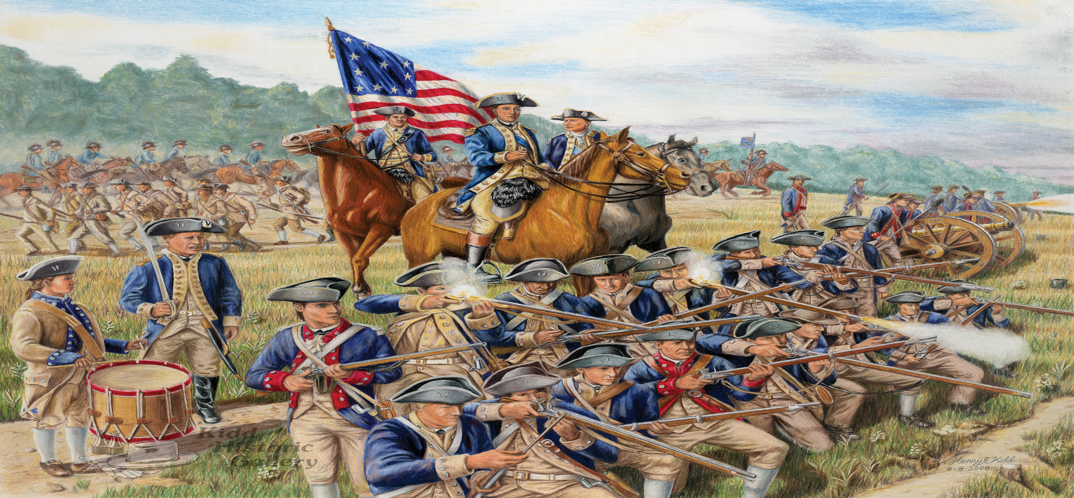
Raising an Army
The Continental Congress established the Continental Army, but relied on the states to recruit soldiers.

Slide 3
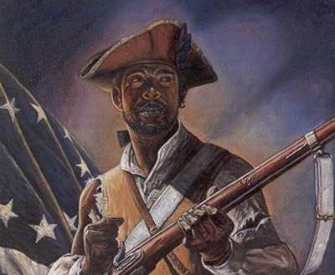
CHOOSING SIDES
African Americans fought on both sides of the war.
PATRIOTS- Many fought because they needed the money. Some fought for the cause: freedom.
LOYALISTS- England guaranteed freedom from slavery after the war.

Slide 4
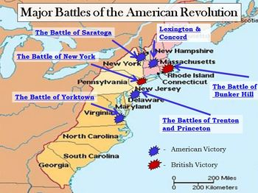
Early Major Battles
The Early years of the war took place in the North.

Slide 5
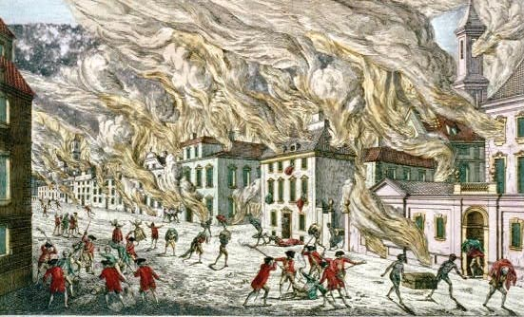
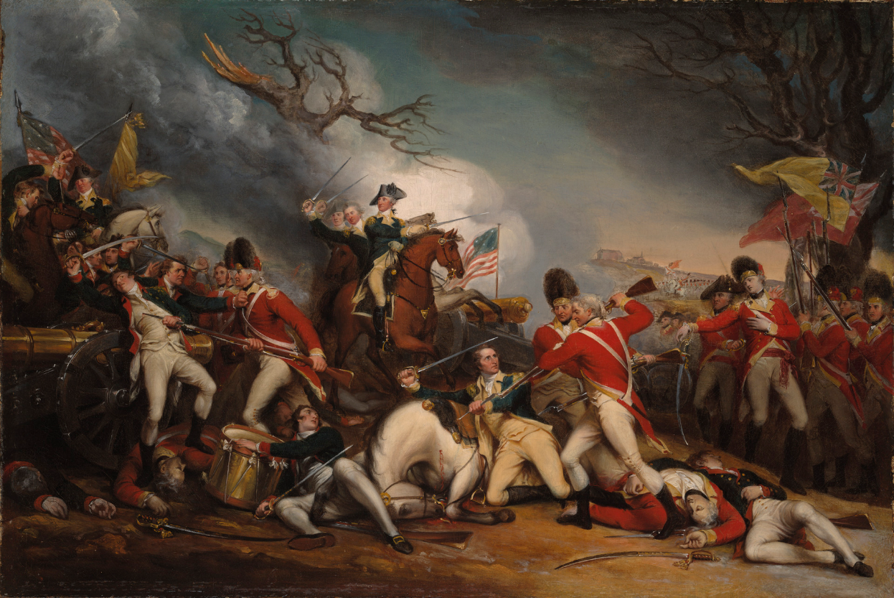
British Victories
New York City was captured on September 13, 1776.
Philadelphia was captured on September 26, 1777.

Slide 6
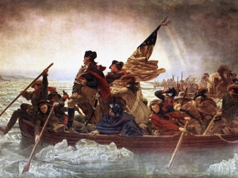
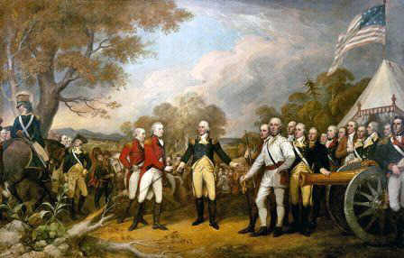
Patriot Victories
New Jersey (Trenton and Princeton)-December 26, 1776.
Saratoga (New York)- October 7, 1777 led by Ethan Allen and the Green Mountain Boys.

Slide 7
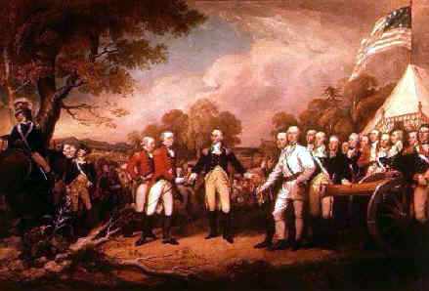
Battle of Saratoga
The Battle of Saratoga proved that colonial militia could defeat trained British soldiers.
The Battle of Saratoga is remembered as the turning point in the war

Slide 8
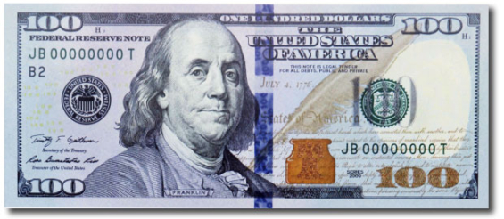
Benjamin Franklin
Benjamin Franklin was key for the Americans
He acted as a diplomat:
representative who works with foreign countries
He was able to convince France to side with the Patriots.

Slide 9
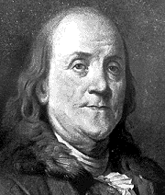
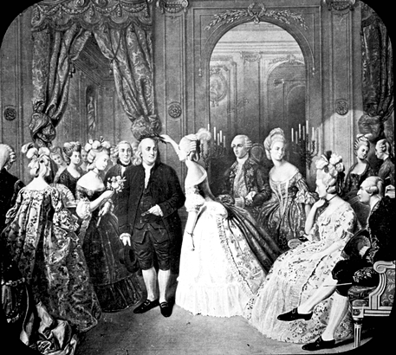
The Most Important Ally
France: In 1778 France declares war on Britain and sent money, equipment and troops to aid the American Patriots.

Slide 10
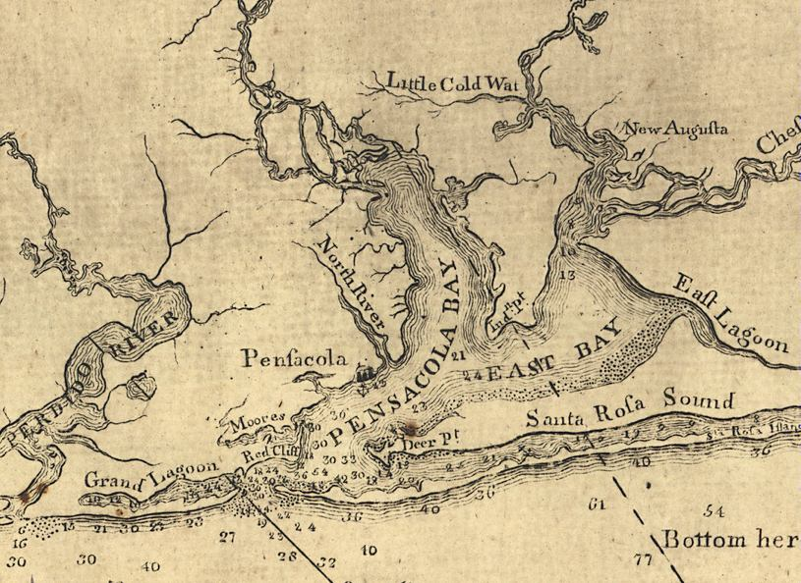
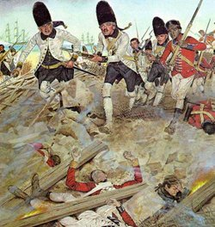
The Americans Gain Allies
Other European nations also helped the American because of their hate for Britain.
Spain declared war on Britain in 1779. Spain captured British forts at Mobile in 1780 and Pensacola in 1781.

Slide 11
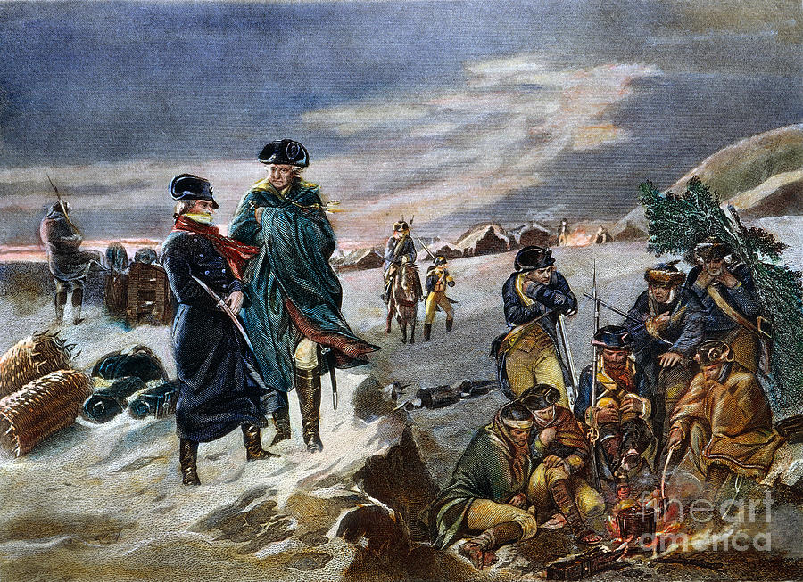
Valley Forge
In the winter of 1778, George Washington endured a winter of suffering at Valley Forge, Pennsylvania.

Slide 12
Valley Forge
At Valley Forge Washington’s men had lack of food, clothing and shelter.
Many men in the Continental Army deserted (left without permission) due to the hardships.
2,000 men died mainly of starvation and cold.
Despite the tragedy, the Continental Army survived the winter.

Slide 13
Valley Forge
While at Valley Forge, a German ally named Baron von Stueben helped train the undisciplined American troops.
He taught American soldiers marching techniques, proper use of firearms and how to utilize bayonets in battle.
Despite the suffering, the Continental Army was a well trained fighting force following Valley Forge.

Slide 14
Marquis de Lafayette
French son of an aristocrat
Comes to Valley Forge in 1775 at 18 years old
"My heart was enlisted and I thought only of joining the colors.“
Becomes Washington’s most trusted commander
Wins victories at Barren Hill, Monmouth, Rhode Island, and Yorktown

Slide 15
Women in the War
Women contributed greatly to the war effort.
Many women held down the home front by taking care of the house and children.
Some followed their husbands to battle.
Many provided entertainment by dancing, singing and keeping the spirits of soldiers up.

Slide 16
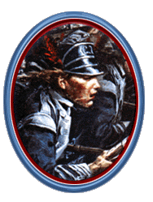
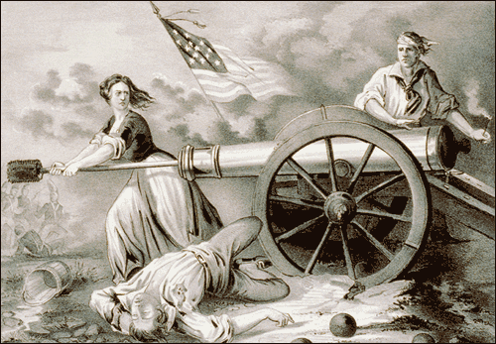
Women in the War
Right: Deborah Sampson disguised as a man in battle.
Below: The famous
“Molly Pitcher.”

