Slide 1
The Articles of Confederation
Chapter 7, Section 1

Slide 2
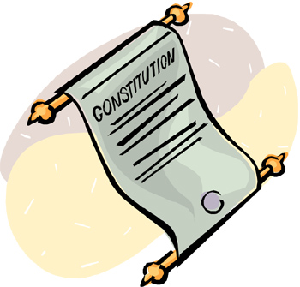
State Constitutions
In May 1776 Continental Congress asked the states to organize their governments.
States began creating individual constitutions: rules under which the government will operate.
By the end of 1776, eight states had drafted constitutions.

Slide 3
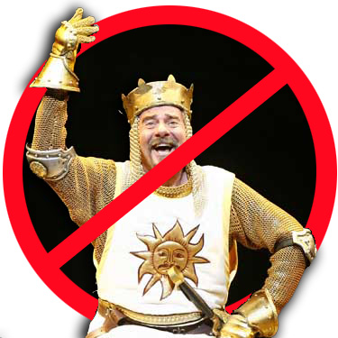
NO MORE KINGS!
British rule had made Americans cautious about placing too much power in the hands of a single ruler.
Most state constitutions even limited the power of their governors.

Slide 4
Limiting Power
Most states established a two-house, or bicameral, legislature to divide the power even further.

Slide 5
Who could vote?
State legislators were elected by the people, however, you had to be white, a male, 21 years of age and a property owner to vote.
So who really could vote?
OLD, RICH, WHITE GUYS

Slide 6
Forming a Republic
Most Americans agreed that their country should be a republic, a government in which citizens rule through elected representatives.
At first, most Americans favored a weak central government .
CENTRAL GOVT.

Slide 7
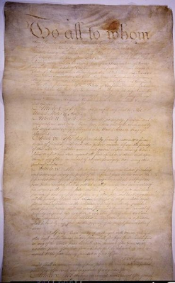
Planning a New Government
In November 1777, the Continental Congress adopted a plan to set up a central government. The plan was called the Articles of Confederation, America’s first constitution.
Under the Articles the power would lie with the states.
STATES

Slide 8
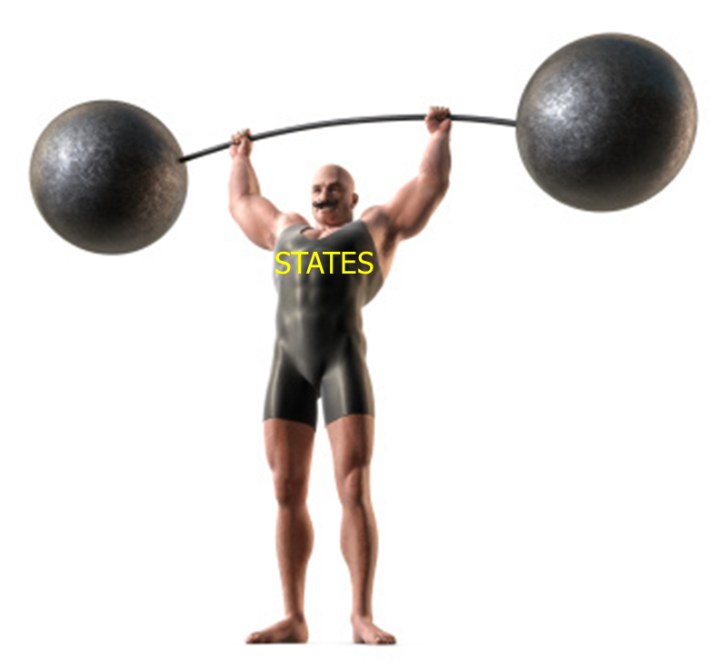
Planning a New Government
Under the Articles of Confederation each state had one vote in Congress despite the size of its population.
States were able to:
Control state militias
Regulate trade
Impose taxes (give revenue to the National Government)

Slide 9
Financial Problems
By 1781 the money printed during the Revolutionary War had depreciated (fallen in value) so much that it was almost worthless.
Fighting the war had left Continental Congress with huge debts and it still owed soldiers money for their military service.
Under the Articles of Confederation the Federal Government could not tax citizens and pay its debts.

Slide 10
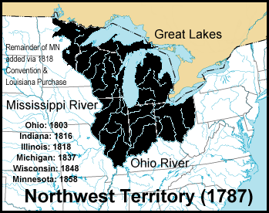
The Northwest Ordinance
Passed in 1787 and created Northwest Territory out of lands north of the Ohio River and east of the Mississippi River.
Divided the land of the Ohio River into territories.
When population reached 60,000 in a territory, the people could request statehood.

Slide 11
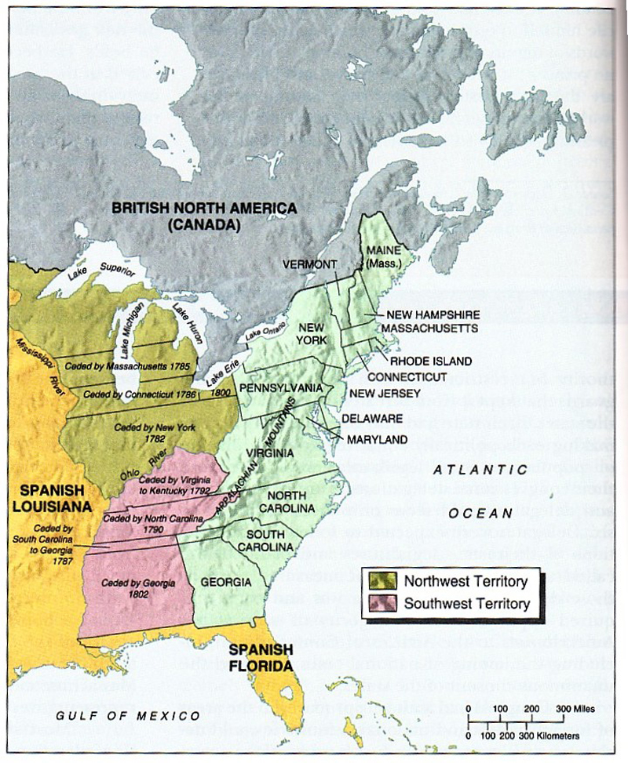

Slide 12
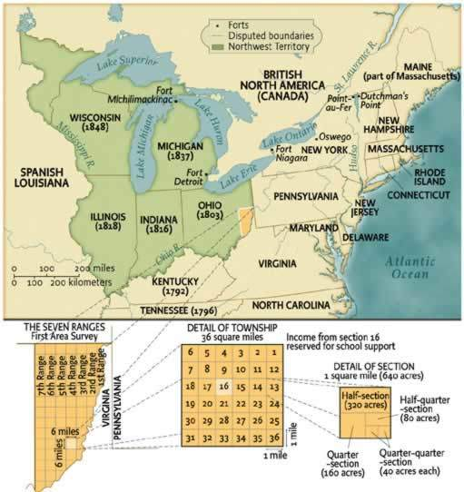

Slide 13
No Slavery!
Under the Northwest Ordinance, slavery would not be allowed in the Northwest Territory
(America’s first attempt to stop slavery).

Slide 14
Problems with Britain
Though the Treaty of Paris was supposed to remove all British troops from America, many still remained in Canada.
Britain was also arming Native Americans.
The British believed the new American government was weak and ineffective.

Slide 16
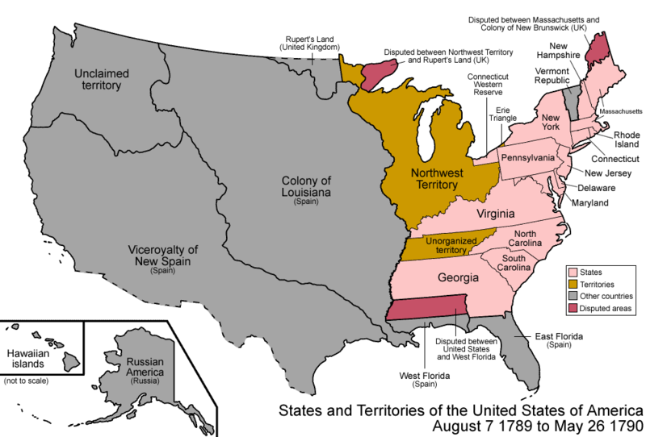
Problems with Spain
Spain controlled Florida and lands west of the Mississippi River. In 1784, Spain prevented Americans from using the Mississippi River, thus, hurting shipping and transportation of goods.

Slide 17
PROBLEMS WITH THE ARTICLES OF CONFEDERATION
COULD NOT TAX
COULD NOT RAISE AN ARMY
COULD NOT ENFORCE LAWS
COULD NOT REACH A CONSENSUS
NO CHIEF EXECUTIVE
WEAK
CENTRAL
GOVT.

Slide 18
Art. of Conf. too weak!
The weaknesses of the Articles of Confederation were obvious.
These problems made many Americans realize that a stronger central government was needed.

