Slide 1
Expanding west
8.2

Slide 2
Westward wishes
Many pioneers had the need and want to travel west.
In 1800 the territory of the United States extended only as far west as the Mississippi River.
Many Americans settled along the Mississippi River. This location allowed them to send their crops and goods down the river to New Orleans where they could be traded.

Slide 3
France is back in America
In 1802, Spain and France made a secret agreement that transferred the Louisiana Territory to France.
Jefferson believed that the French were trying to build an empire in North America.

Slide 4
Napoleon’s world empire
Due to a war with Britain in Europe and a slave revolution in Haiti, Napoleon was willing to cut ties with his “New World Empire”.

Slide 5
Toussaint L’ouverture (1743-1803)
“I was born a slave, but nature gave me a soul of a free man….”

Slide 6
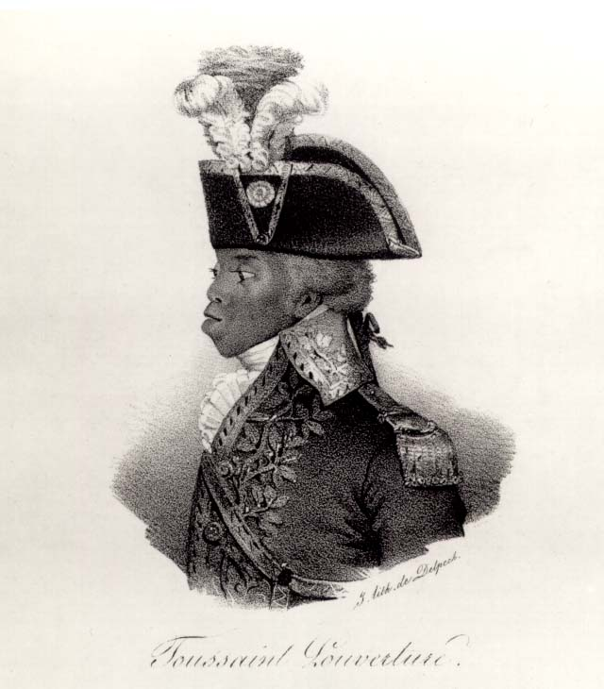
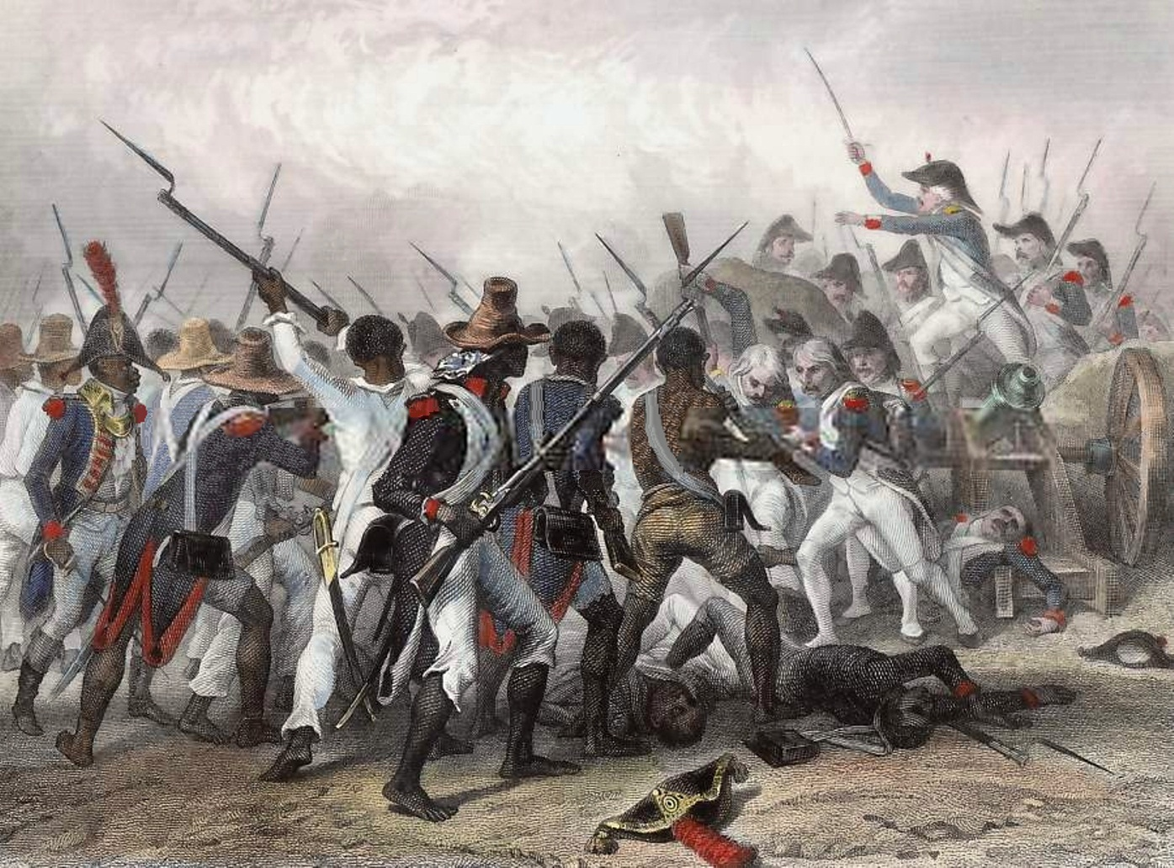
Toussaint L’ouverture
Leader of the Haitian Revolution, which was the only successful slave revolution in history.
L’ouverture defeated Napoleon, who many consider to be the greatest military strategist in history.
The cost of the Haitian Revolution eventually forced the French to sell the Louisiana territory to America.

Slide 7
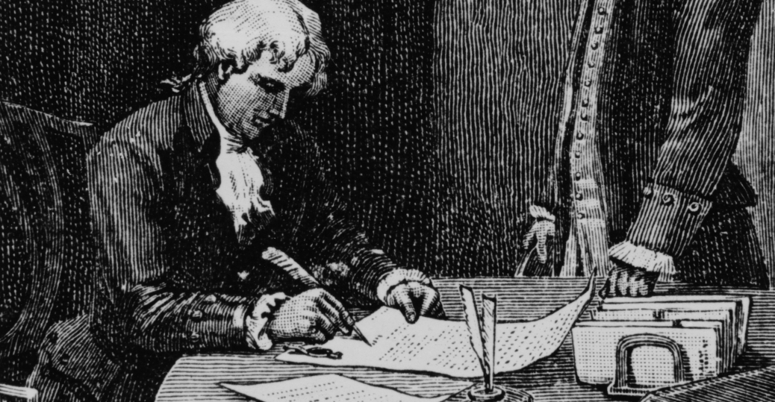
The Louisiana Purchase
The United States and France agreed on the purchase price of $15 million.
$0.03 an acre
In 1803, the Louisiana Purchase doubled the size of the United States.

Slide 8
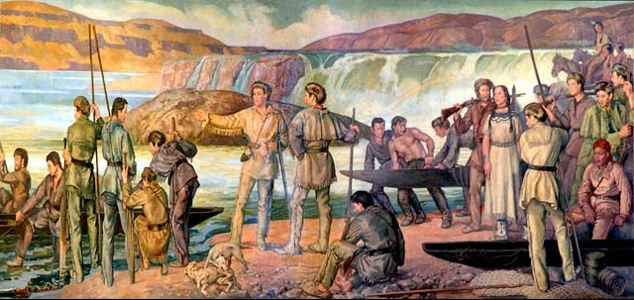
Exploring the new territory
Jefferson wanted to learn more about the mysterious lands west of the Mississippi River so he persuaded Congress to sponsor an expedition.
Jefferson saw the expedition as:
A scientific venture
A chance to find a passage to the Pacific Ocean
Plot sites for future forts.
Create maps of the area.

Slide 9
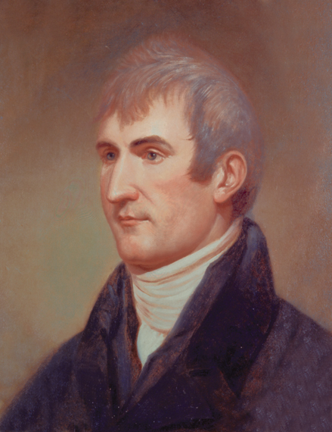
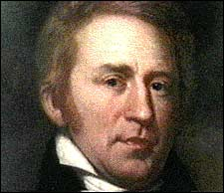
Lewis and Clark
To head the expedition, Jefferson chose his private secretary, 28 year old Meriwether Lewis.
The expeditions co-leader was 32 year old William Clark.

Slide 10
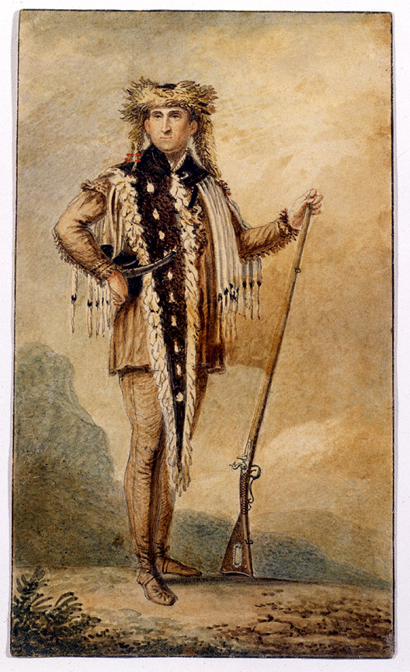
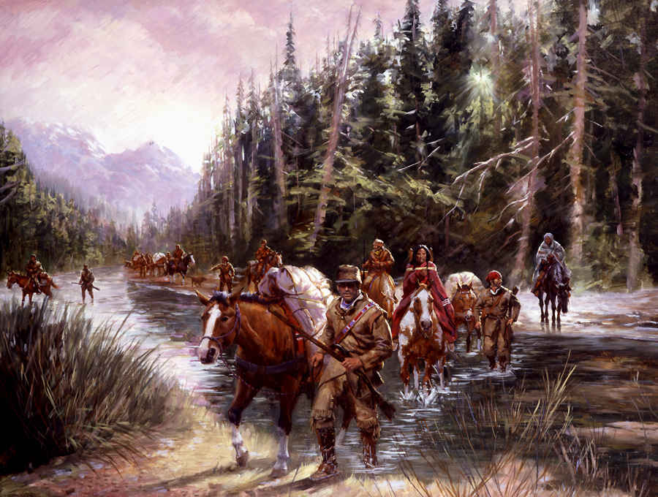
The Corps of Discovery
Lewis and Clark assembled a crew that included expert river men, gunsmiths, carpenters, scouts, a cook, two men of mixed Native American and French heritage (that served as interpreters), and an African American slave named York.

Slide 11
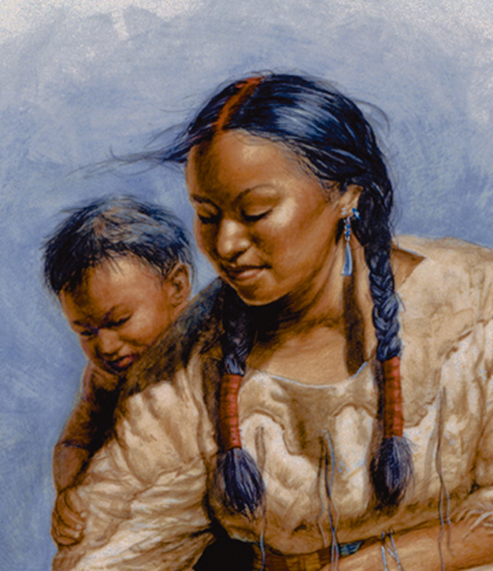
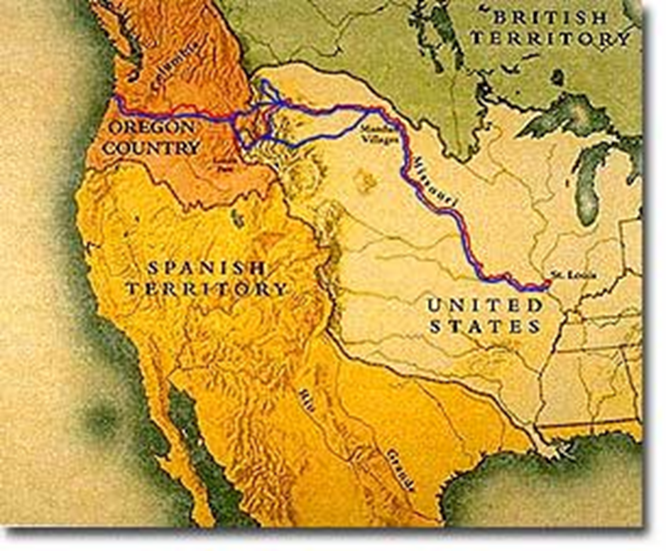
Lewis and Clark
The expedition left St. Louis and slowly worked its way up the Missouri River. Both Lewis and Clark kept journals of what they saw and did.
One young Shoshone woman named Sacagawea joined the group as a guide.

Slide 12
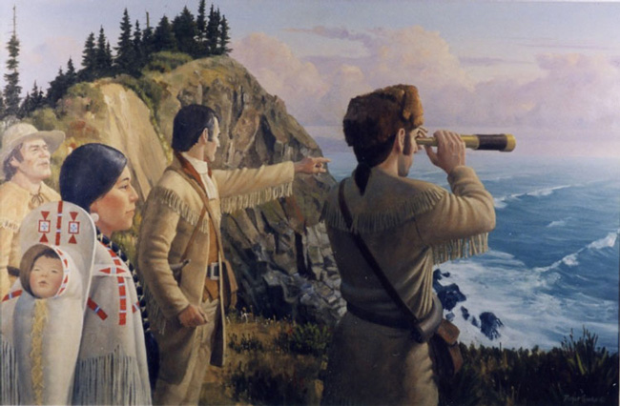
Lewis and Clark
After more than 18 months and nearly 4,000 miles, Lewis and Clark reached the Pacific Ocean.
They faced many hardships
Illness
Hostile natives
Lack of food
The expedition returned in 1806, with only 1 person dead.

Slide 13
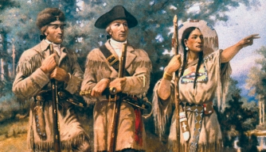
Lewis and Clark Results
New information about Native American culture.
A map showing a new route to the Pacific Ocean
Knowledge about plants and animals in the west.

