Slide 1
WESTWARD EXPANSION
Chapter 13.1 & 13.2
The West

Slide 2
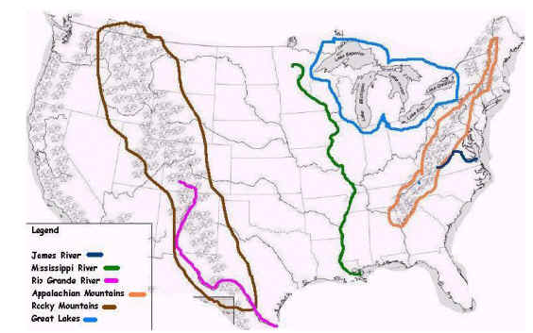
What was “the West”?
Early Americans answer: “the area between the Appalachian Mountains and the Mississippi River.

Slide 3
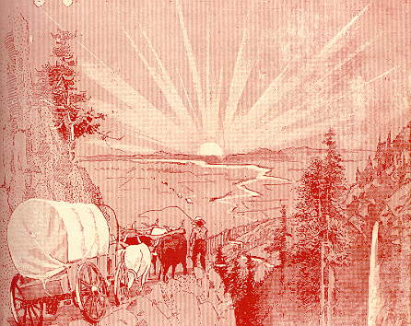
What was “the West”
By the 1820’s most of that area had been settled.
Settlers wanted to push to the western frontier.
Frontier- land that forms the farthest extent of the nation.

Slide 4
The Great Plains
Area between the Mississippi River and the Rocky mountains.
Unattractive to settlement

Slide 5
The Northwest
Modern day areas of Oregon and Washington
Settlers were attracted to its fertile land.
U.S., Great Britain, Russia, and Spain all claimed this area.

Slide 6
The Southwest
Mexico gains independence in 1821.
This eventually will create land conflicts with the ever expanding U.S.

Slide 7
Manifest Destiny
The belief that the US was destined to extend from Atlantic to Pacific Ocean.
“ The American claim is by the right of our manifest destiny to overspread and possess the whole of the continent which Providence has given us for the development of the great experiment of liberty and self government entrusted to us.”
-John L. O’Sullivan

Slide 8
