Slide 1
13.2 TRAILS TO THE WEST

Slide 2
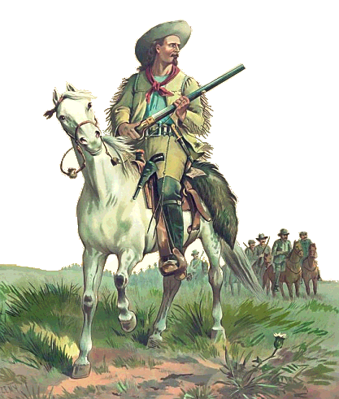
Trails to the West
The first American frontiersmen were traders.
They were looking for new markets to sell their goods

Slide 3
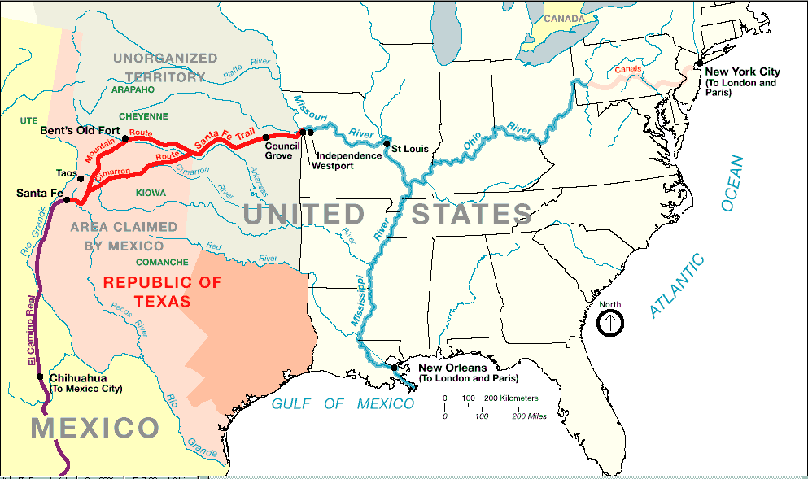
Santa Fe Trail
Trade route that stretched from Missouri to Santa Fe, New Mexico.

Slide 4
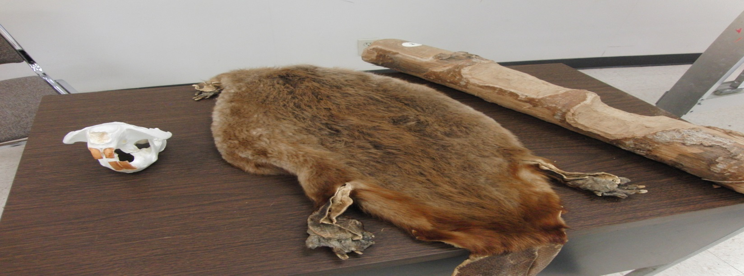
Oregon Fur Trade
Fur traders made a fortune in the Oregon Territory.
“The annual quantity of these furs could not be exactly ascertained, but Mr. Smith was informed indirectly that they amounted to about thirty thousand beaver skins, besides otter skins and small furs. The beaver skins alone, at the New York prices, would be worth above two hundred and fifty thousand dollars. “

Slide 5
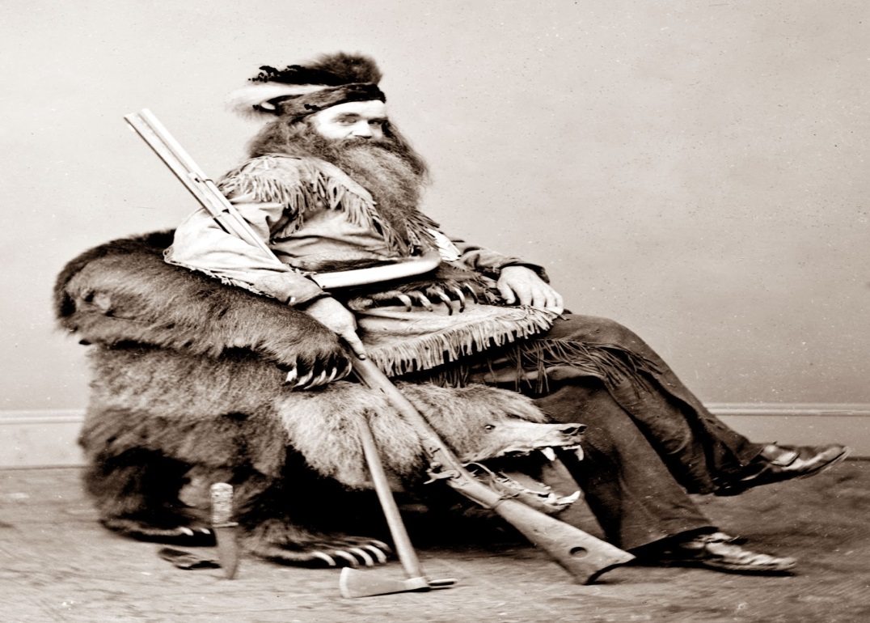
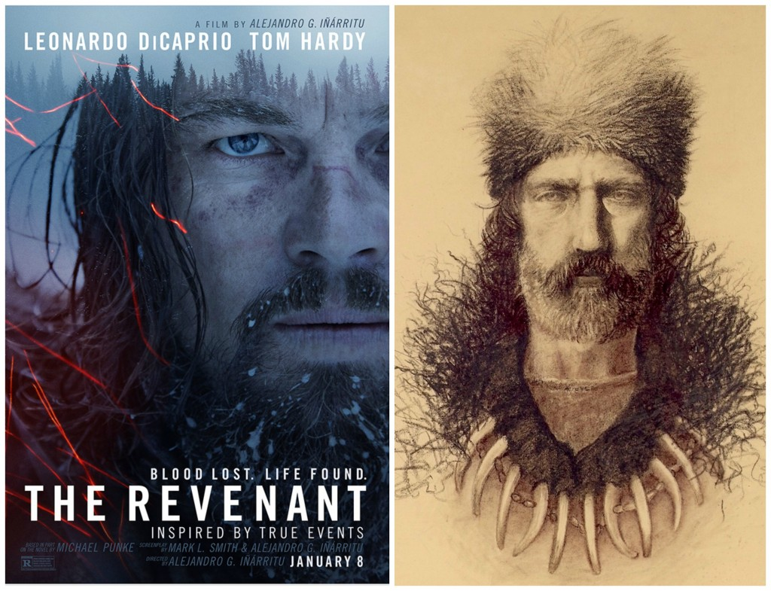
Mountain Men
Fur trappers of the Northwest
Led isolated lives in the wilderness.
Men like Jedidiah Smith and Hugh Glass become well known for their unbelievable toughness.

Slide 6
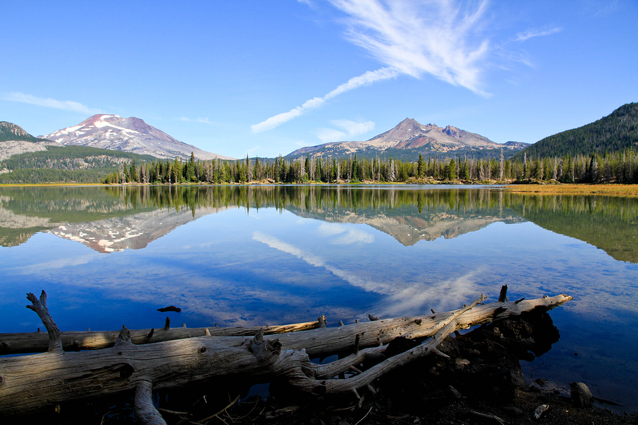
“Oregon Fever”
Settlers sought after the free and fertile land of the Oregon Territory.

Slide 7
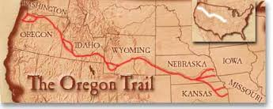
Oregon Trail
Most settlers traveled the 2,000 mile long trail to get from Missouri to Portland, Oregon.

Slide 8
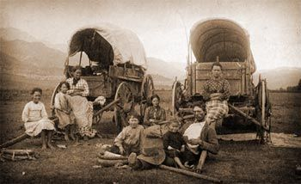
Oregon Trail
Settlers were willing to make the long journey for several reasons:
A fresh start
Fur trading
Farm land

Slide 9
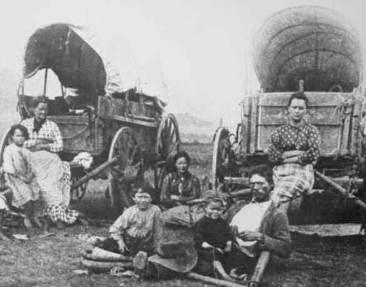
Oregon Trail
The long trip was extremely hazardous
Travelers experienced disease, accidents, lack of water and harsh weather.
Despite all the hardships over 50,000 people reach Oregon between 1840 and 1860.

Slide 10
