Slide 1
Conflict with Mexico
Ch. 13.3

Slide 2
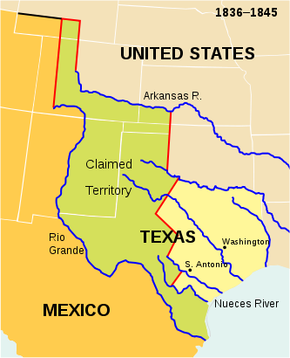
Manifest Destiny
Mexico gained its independence from Spain in 1821.
As the idea of spreading west became popular, more Americans began moving onto Mexican lands.

Slide 3

Differences
Mexicans
Texans
Catholic
Banned slavery
Dictatorship
Protestant
Grew cotton (slavery)
Democratic

Slide 4
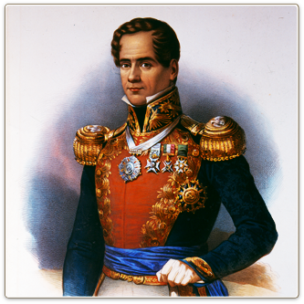
War is Coming
Americans continue to flood onto Mexican territory.
1830: Mexico bans settlement
1833: General Antonio Lopez de Santa Anna becomes dictator of Mexico
Texans are urged to revolt against the Mexican government

Slide 5
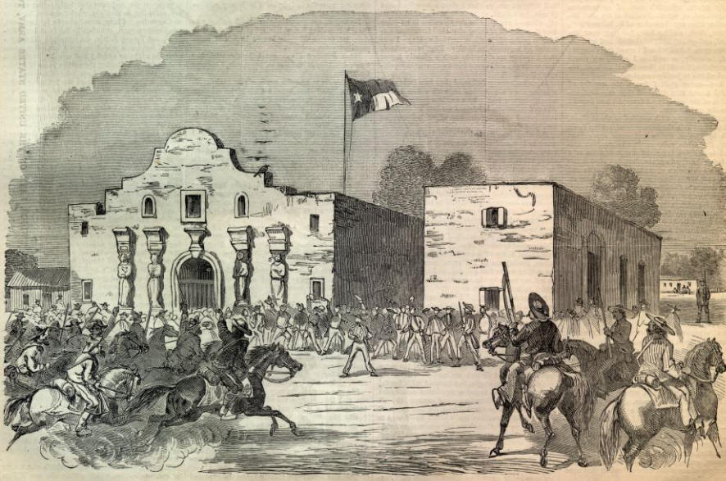
The Alamo
A Spanish mission in San Antonio.
Santa Anna leads a force of 1500 men to retake the position.

Slide 6
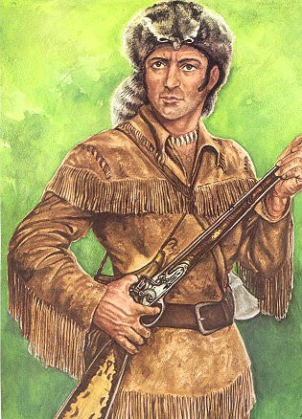
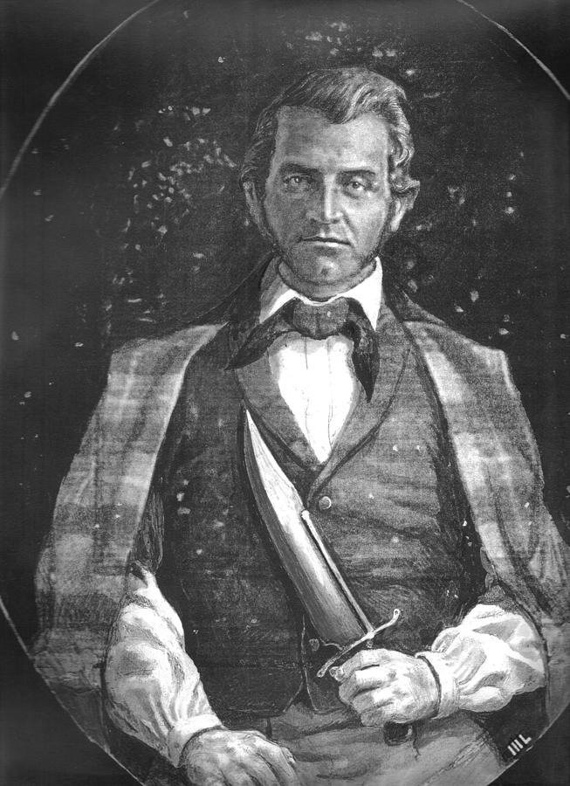
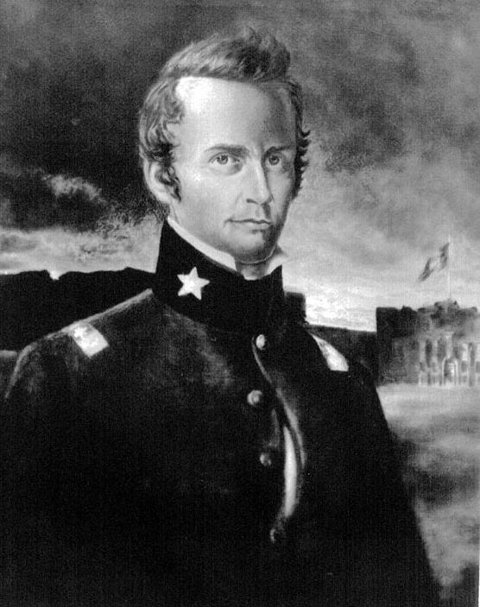
Famous Men at the Alamo
Jim Bowie- led the militia at the Alamo
William Travis- commander of the Alamo garrison
Davy Crockett- frontiersman and legendary folk hero

Slide 7
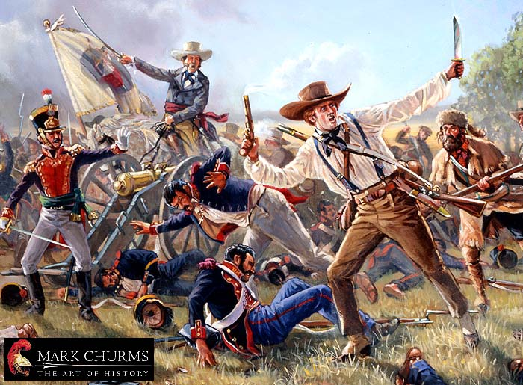
“Remember the Alamo!”
For 12 days, the Texans held the mission.
  Eventually overran by the Mexican army
  All 185 killed or executed
Texas forces would use the motto “Remember the Alamo!” to motivate troops in future battles..

Slide 8
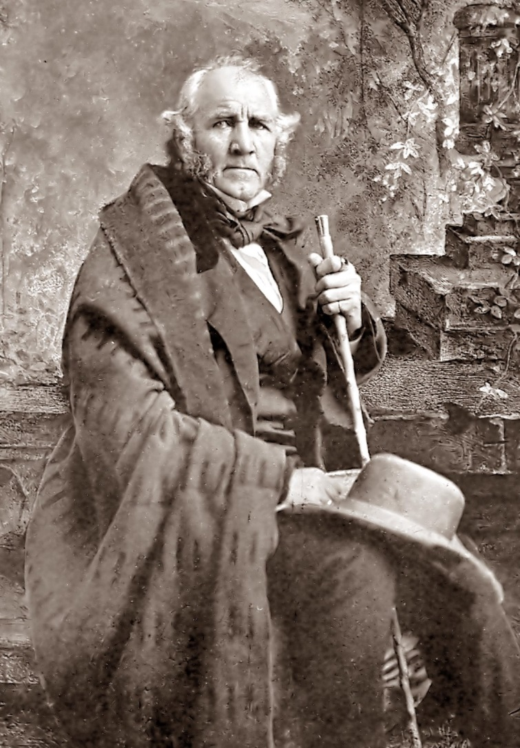
Texas Independence
After the Alamo, Sam Houston led the Texan army against Santa Anna’s army at San Jacinto.
  Santa Anna signs a treaty that recognizes Texas’ independence.

Slide 9
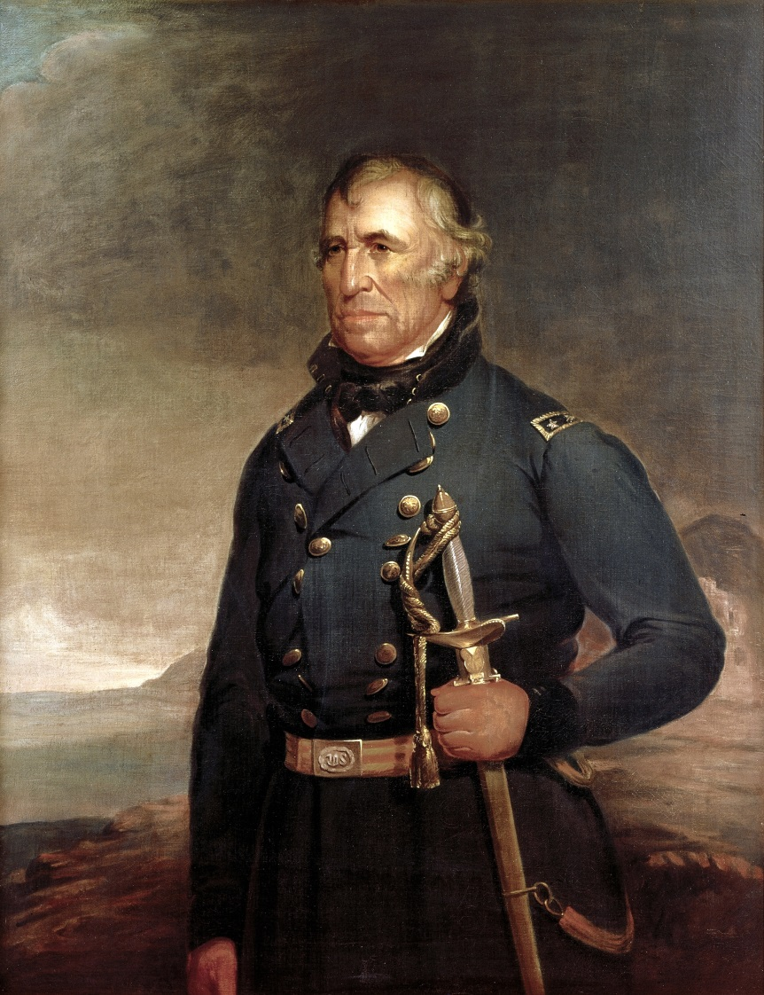
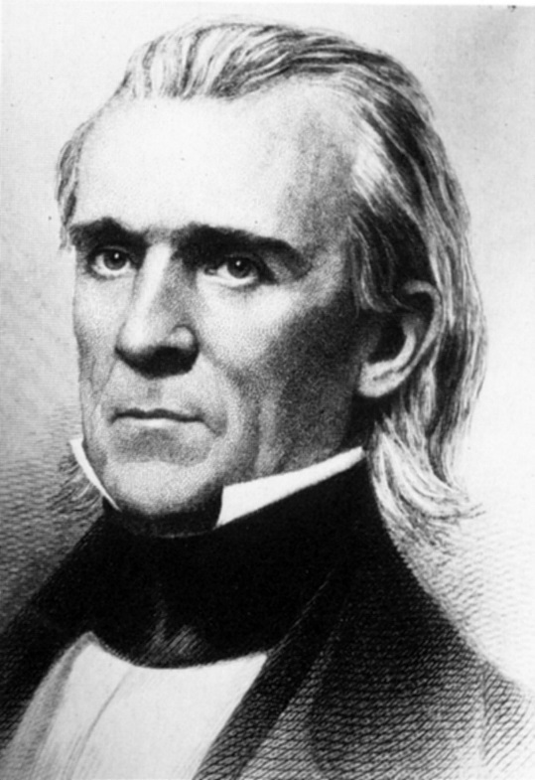
Mexican-American War
James Polk tried to buy California and other Mexican territories
Mexico refused.
  Polk sends Zachary Taylor into Mexican territory to provoke a war.
    The Mexican army ambushed he and his men.
The War begins

Slide 10
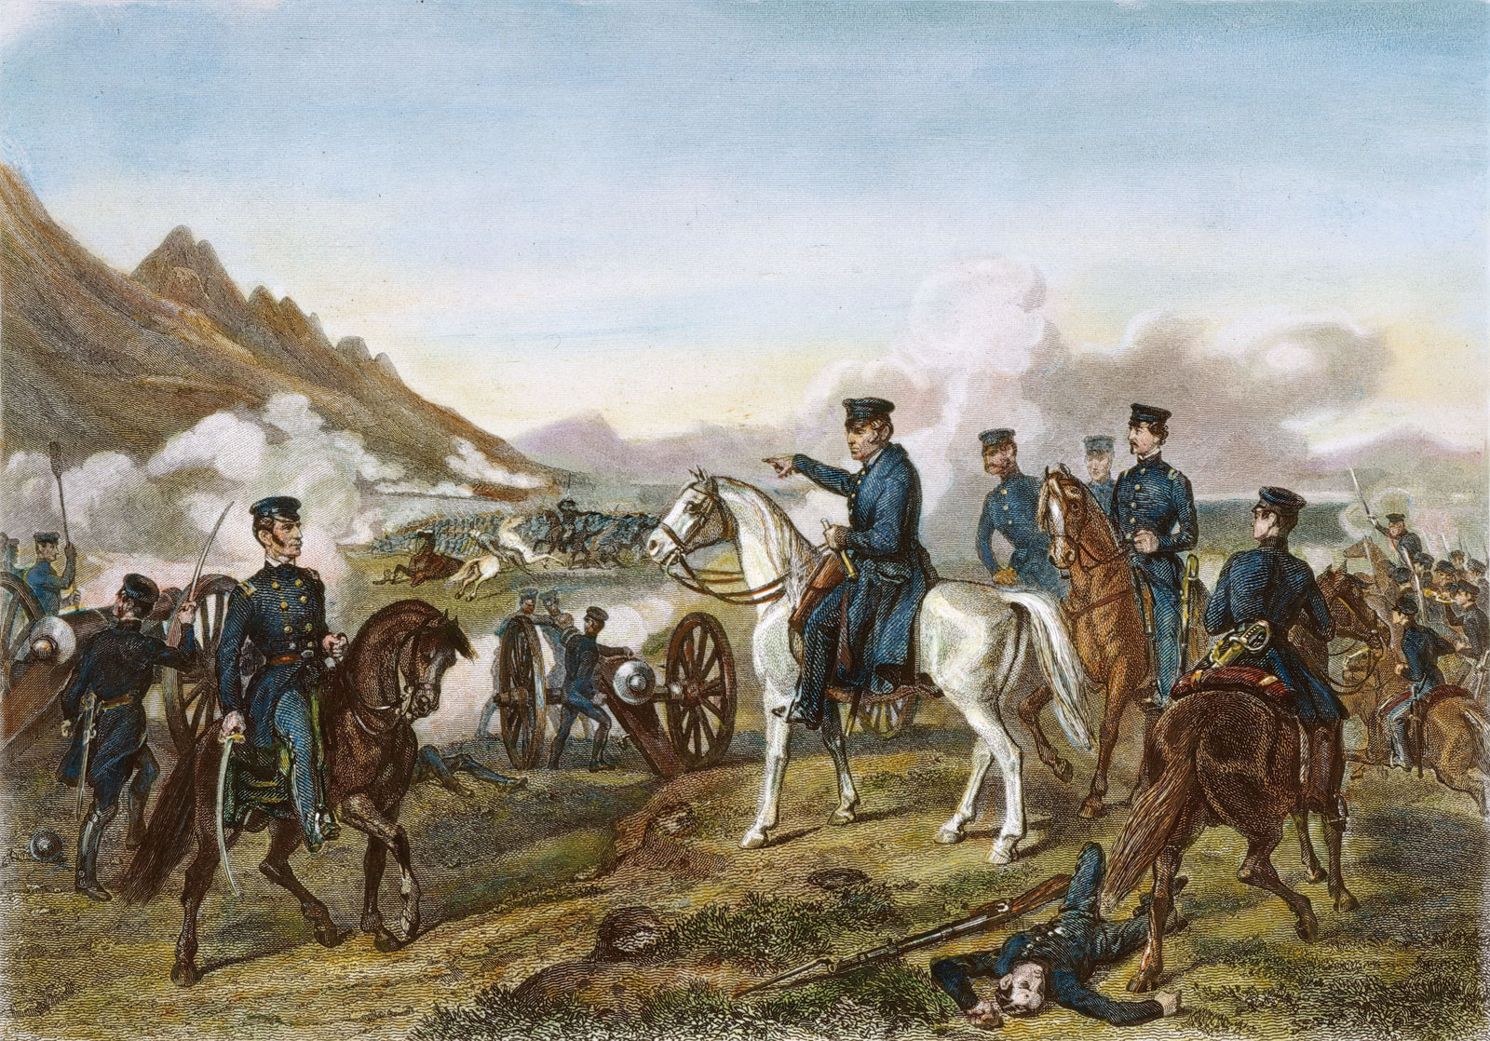
“Mr. Polk’s War”
Polk sends troops into the Southwest.
  Very quickly takes control of New Mexico and California.
Zachary Taylor moves troops into Mexico.
  Wins major battles at Monterrey and Buena Vista

Slide 11
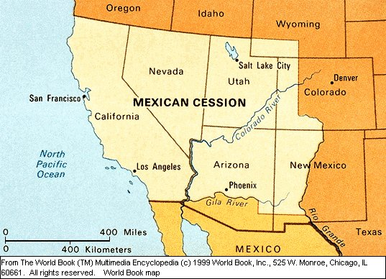
War Ends
American forces capture Mexico City.
The Treaty of Guadalupe-Hidalgo officially ends the war.
Mexico loses a vast amount of territory:

Slide 12
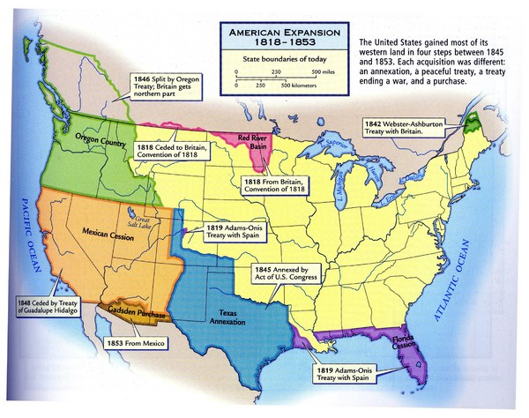
Manifest Destiny Achieved
With the Gadsden purchase in 1853, the United States officially becomes “Continental”

