Slide 1
A Rush to the West
Chapter 13.4

Slide 2
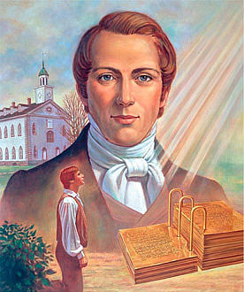
Mormons
Religious group founded by Joseph Smith in 1830
Joseph Smith reveals his heavenly visions in his Book of Mormon
Many disagreed with his teachings
Shared property, polygamy
Hostilities force Mormons out of communities
New York>Ohio>Missouri>Illinois
Smith murdered in Illinois

Slide 3
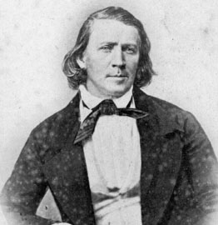
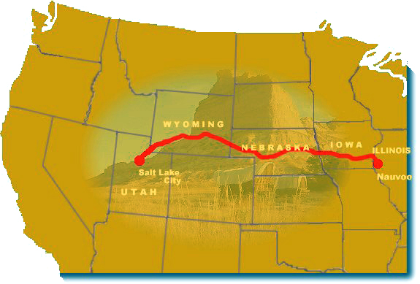
Seeking Refuge
Led by Brigham Young, the Mormons left Illinois and headed west.
Ended up in Salt Lake City, Utah.
The differences between Mormons and the United States caused initial difficulty.
Eventually in 1892 Utah becomes a state.

Slide 4
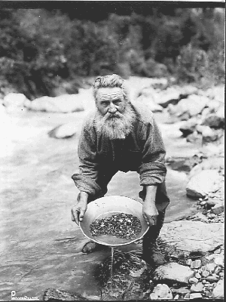
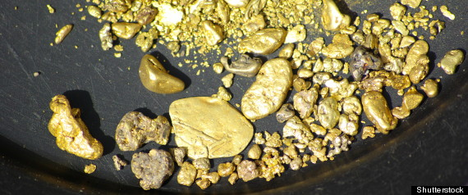
California Gold Rush
Starts in 1849
80,000 prospectors moved in search of gold.
Miners took the law into their own hands
Miners known as “49ers”

Slide 5
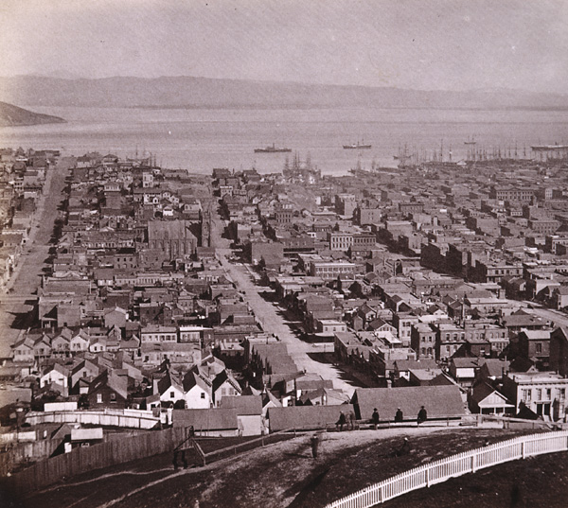
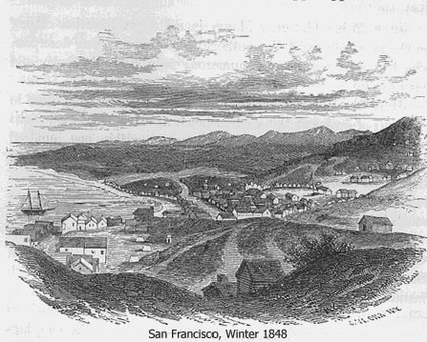
California
Though most towns were temporary, some cities boomed.
San Francisco becomes an important trade port.
1848: 200 people
1870: 100,000 people

Slide 6
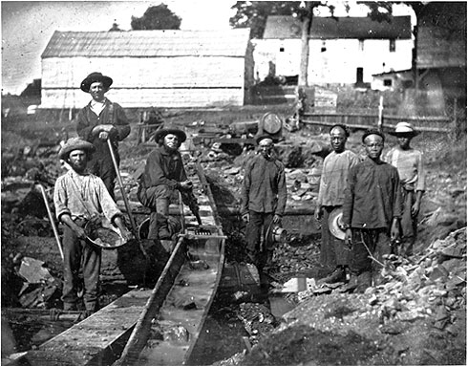
Cultural Diversity
People around the world flocked to California.
The gold rush brought enormous ethnic diversity to California.
40% European immigrants
45,000 Chinese immigrants
Several thousand free African Americans

