Slide 1
Chapter 14 part 2

Slide 2
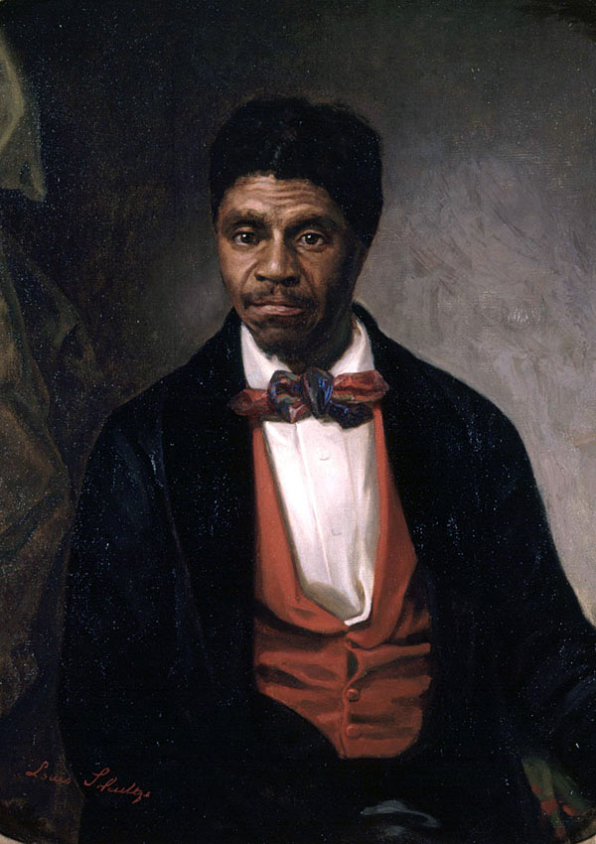
Dred Scott
Dred Scott was an enslaved man who was owned by an Army doctor.
The doctor and Scott lived in Illinois and Wisconsin before returning to Missouri.
Illinois and Wisconsin = slavery is illegal

Slide 3
Dred Scott case
Scott sued for his freedom.
He argued that he was free because he had lived in a place where slavery was illegal.
The decision:
1. Dred Scott was not a free man
2. Scott had no right to sue because slaves are not citizens
3. Living in a free territory does not make a slave free.
4. Slaves are property, and the Constitution protects property rights
5. Congress did not have the power to prohibit slavery anywhere

Slide 4
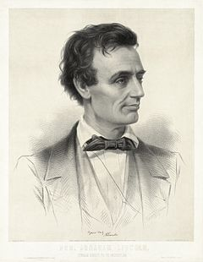
Reaction
Supporters of slavery rejoiced.
Slavery was now legal everywhere
Northerners were outraged
An Illinois lawyer spoke out against the decision:

Slide 5
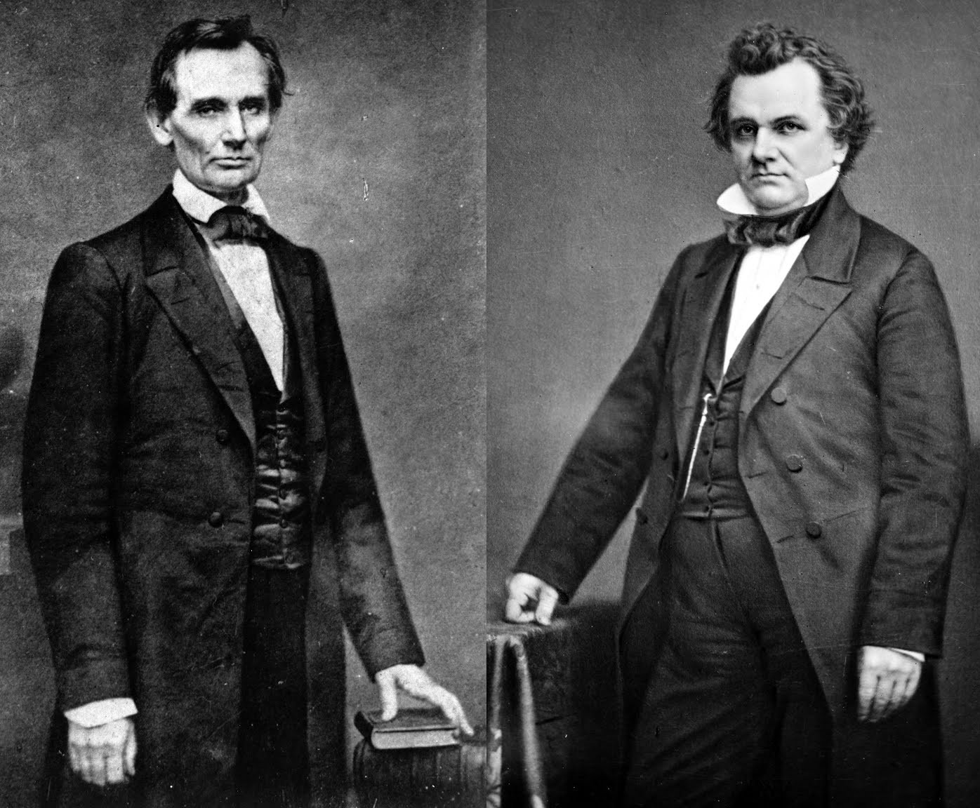
Lincoln-Douglas debate
1858, Abraham Lincoln and Stephen Douglas ran against each other to be the senator of Illinois.
Despised one another: Different political ideas and both courted Mary Todd (Abe won)
Lincoln challenged Douglas to a debate
Douglas supported popular sovereignty
Tried to make Lincoln out to be a dangerous abolitionist.
Lincoln stood against the spread of slavery.

Slide 6
The debates
Lincoln
Douglas
“If slavery is not wrong, nothing is wrong”
Americans are obligated to keep slavery out of western territories.
“there is no reason in the world why the Negro is not entitled to…the right to life, liberty and the pursuit of happiness.”
“Each state has a right to do as it pleases on the subject of slavery.”
“It is none of our business (Illinois) whether slavery exists in Missouri”

Slide 7
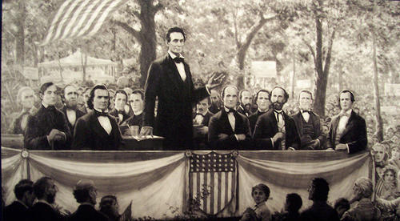
Douglas wins
Though Lincoln lost the election for Senate, he became a national celebrity.
Two years later, the two would once again face off, but this time for the presidency.

Slide 8
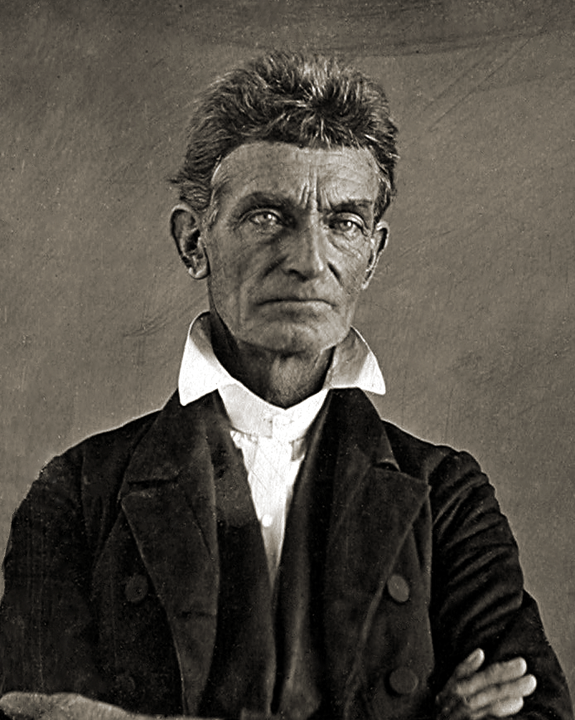
John brown
American abolitionist who believed armed insurrection was the only way to overthrow the institution of slavery.
After his attacks in Kansas, Brown moved back to New England

Slide 9
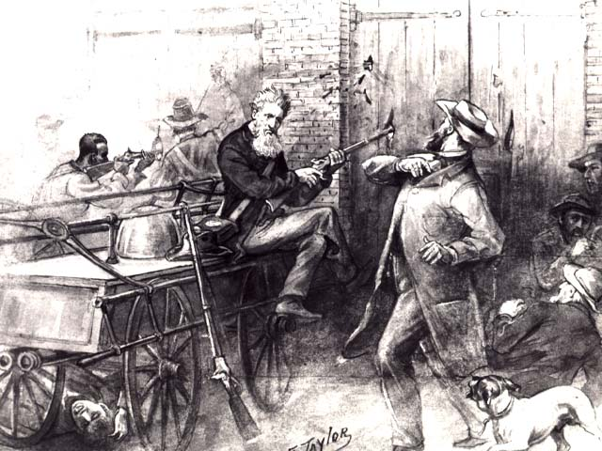
Raid on Harpers Ferry
In 1859 Brown led he, his sons and other followers to Harpers Ferry, Virginia.
His plan was to attack the arsenal and arm African American slaves for a revolt.

Slide 10
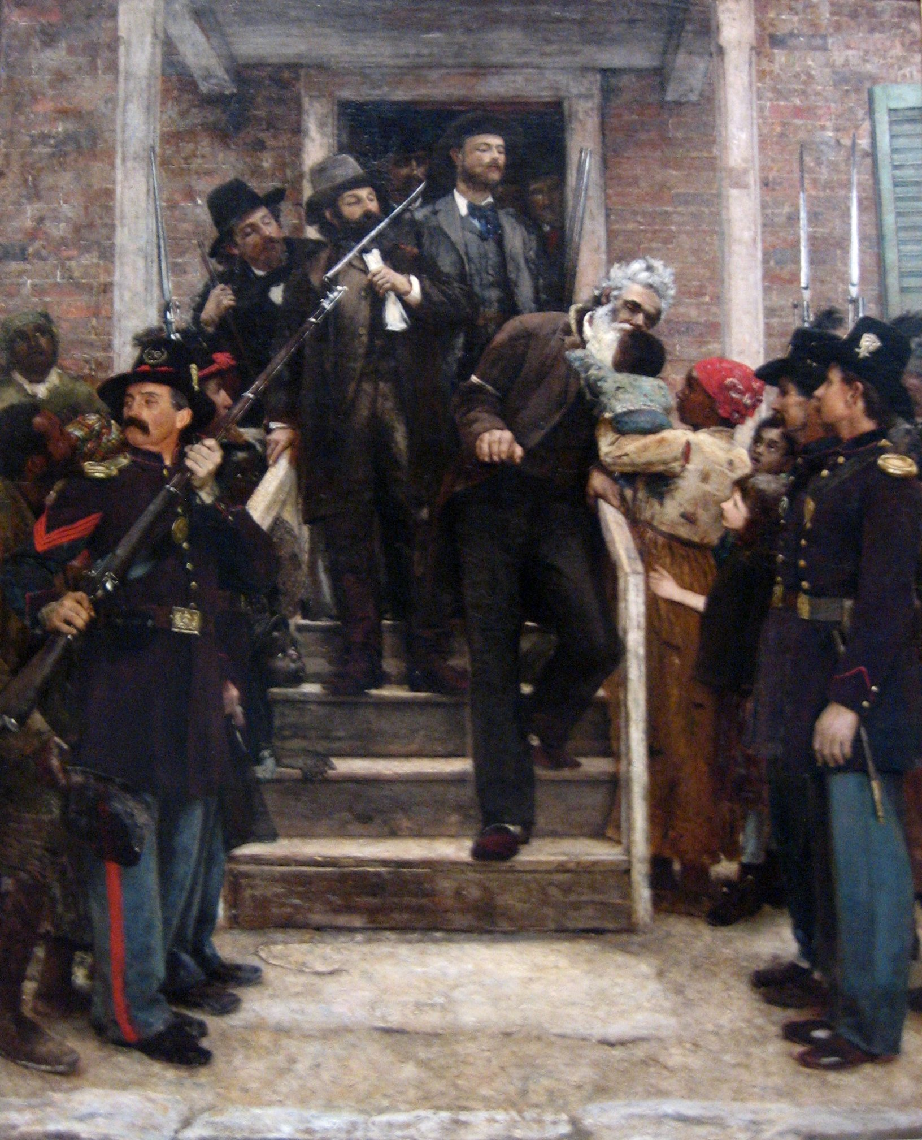
results
John Brown expected slaves to runaway and join him at the arsenal and it did not happen.
10 of his men were killed and he was arrested and hung.
The north mourned him as a hero and martyr.
The south was convinced their way of life was being attacked.

Slide 11
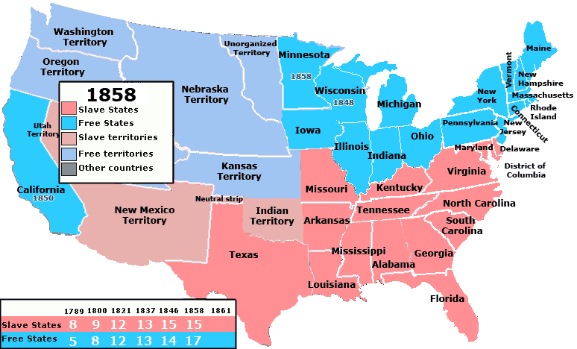
An approaching War
Americans everywhere sensed a crisis
Slavery had seriously divided the country.
The incident at Harpers Ferry, as well as the growing strength of the Republicans had southerners worrying about their future.

Slide 12
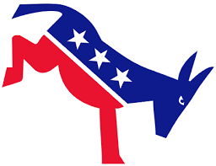
The Democrats split!
The Democratic party could not decide on a candidate!
Northern Democrats wanted to stick with a candidate who believed in popular sovereignty.
Southern Democrats wanted to take a strong stance backing states’ rights.

Slide 13
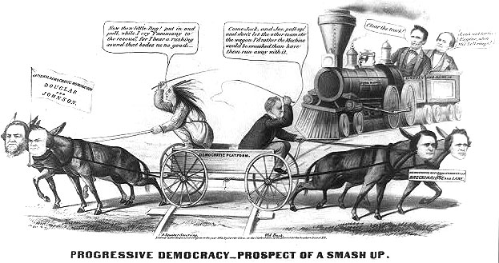

Slide 14
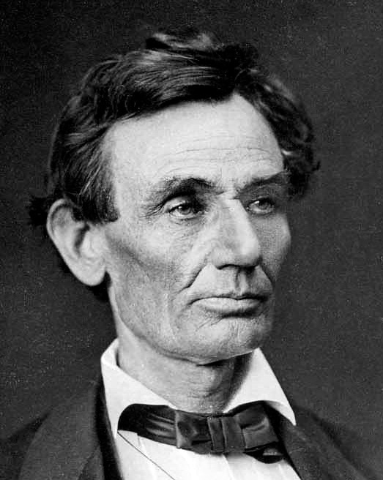
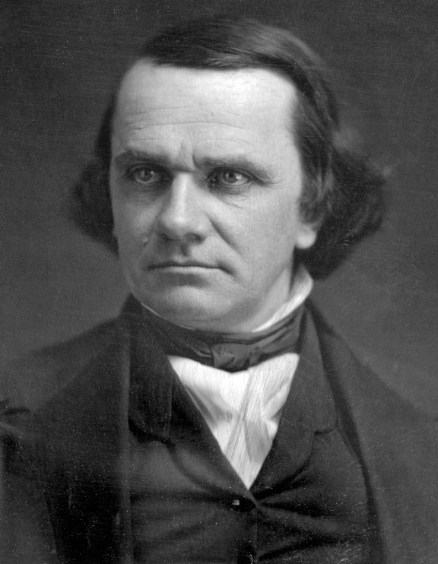
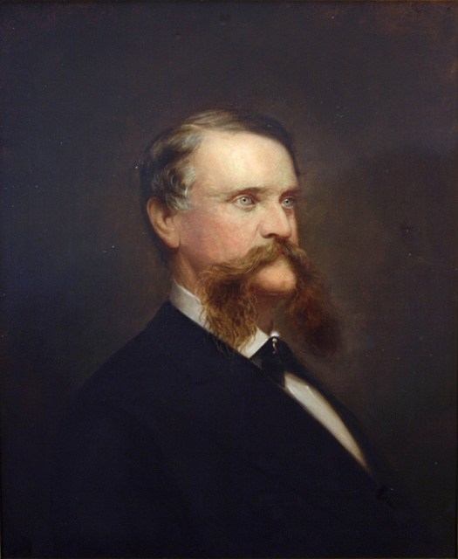
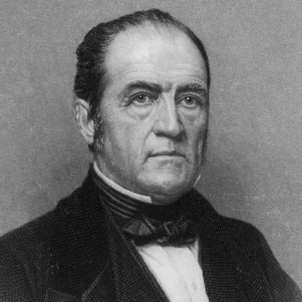
Election of 1860
The Republicans quickly selected Abraham Lincoln to represent them.
Southerners were split.
Northern Democrats: Stephen Douglas(popular sovereignty)
Southern Democrats: John C. Breckinridge(states’ rights)
Union Party: John Bell (protect slavery and keep union)

Slide 15
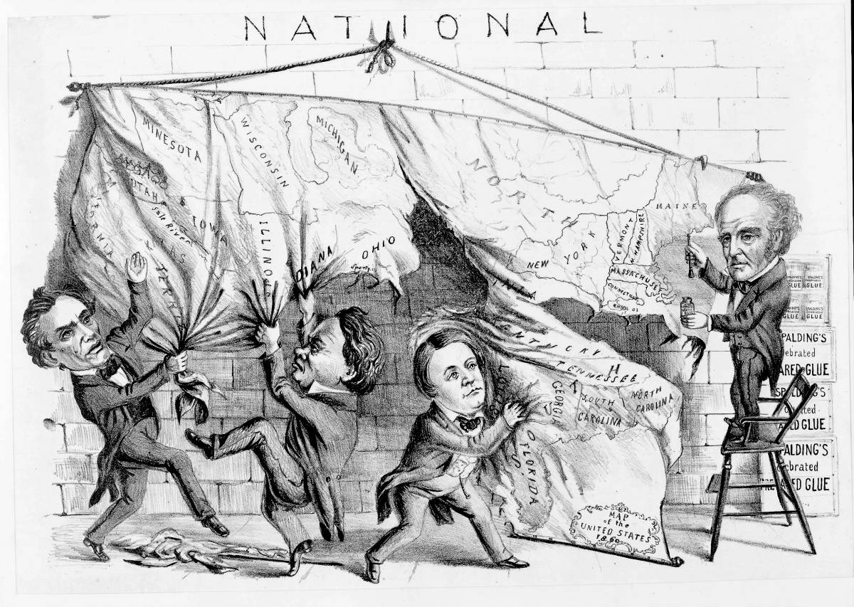

Slide 16
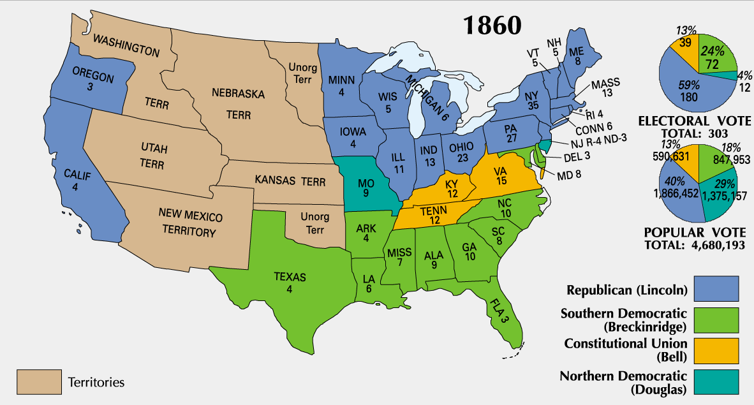

Slide 17
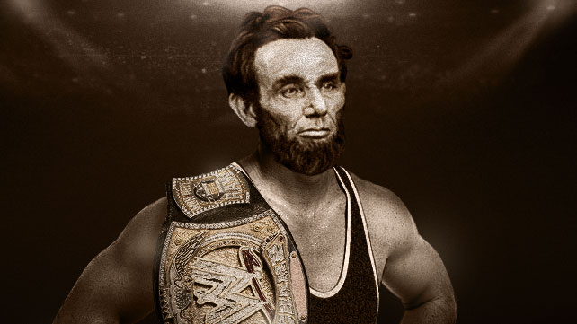
Lincoln wins!

Slide 18
THE NOT SO “UNITED” STATES
The south is enraged.
Congress and now the President have hate for their way of life.
“A party (Republican) founded on the single sentiment of hatred of African slavery, is now the controlling power. The honor, safety, and independence of the Southern people are to be found only in a Southern Confederacy.”

Slide 19
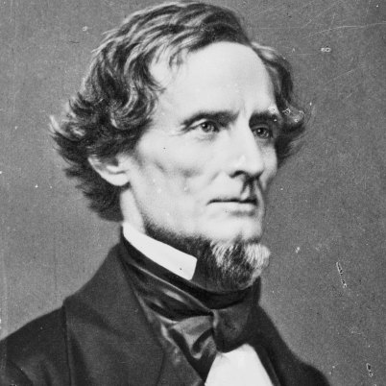
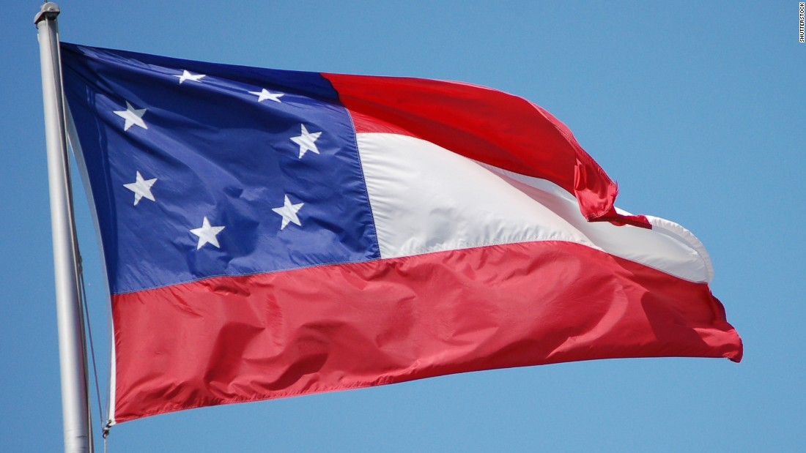
Secession
South Carolina becomes the first state to secede.
SIX MORE STATES FOLLOWED forming the Confederate States of America:
MS, FL, AL, GA, LA, and TX
Justified their succession with the theory of states’ rights
They selected Mississippi senator Jefferson Davis as their president.

Slide 20
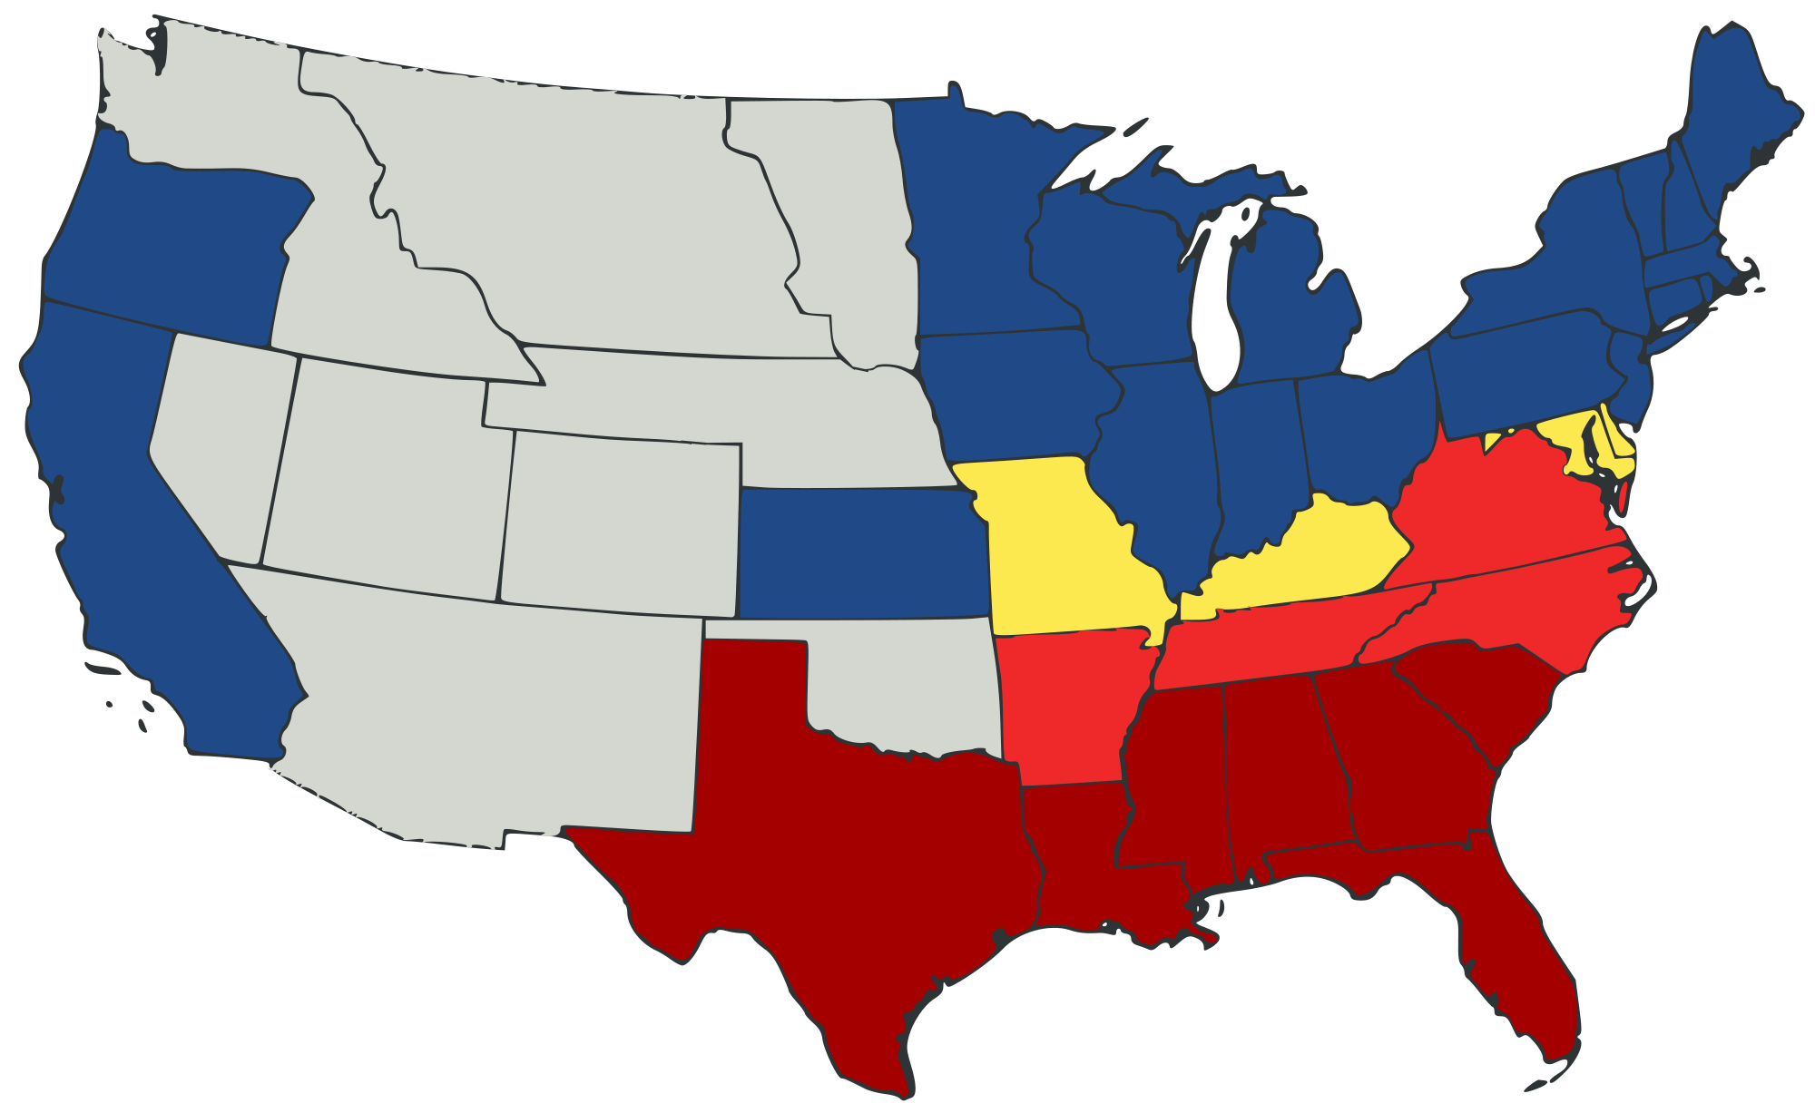

Slide 21
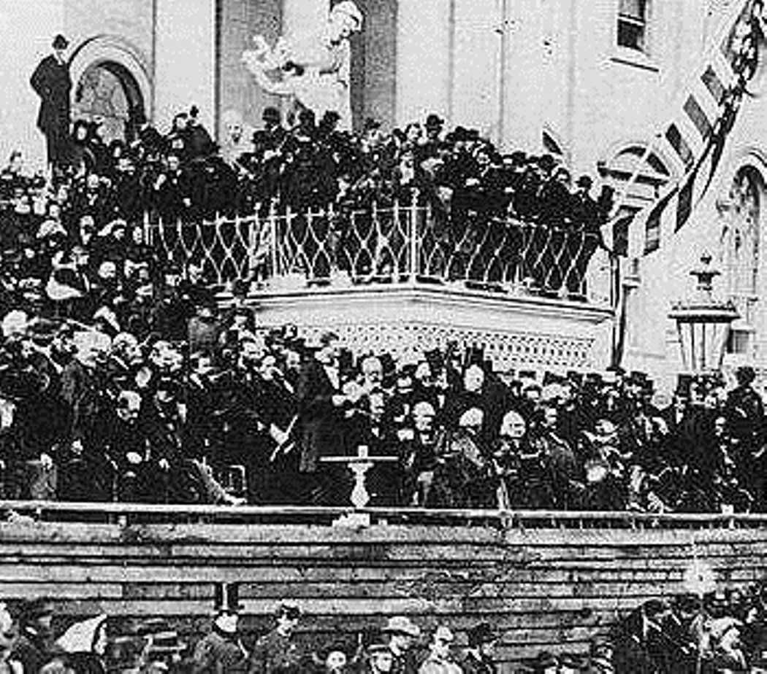
The civil War begins
On March 4, 1861, Abraham Lincoln became President of a nation facing the greatest crisis in its history.
He promised in his inaugural address to try and protect the Union
But he also warned the south about continuing with their current actions.

Slide 22
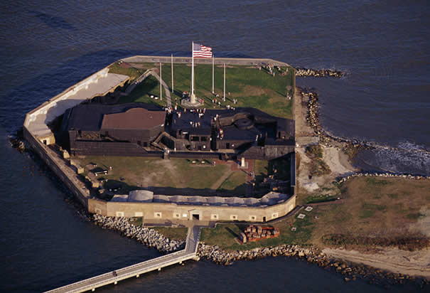
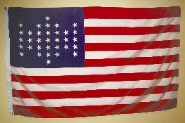
Fort Sumter
An island fortification located in South Carolina

Slide 23
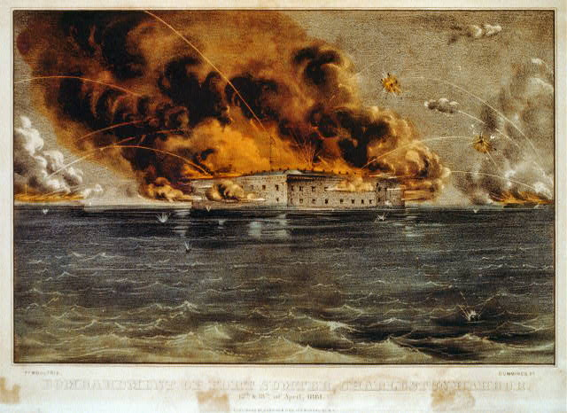
Fort Sumter
After South Carolina seceded, US Army commander Robert Anderson refused to abandon his post.
On April 12, 1861the Confederacy attacked the fort.
By days end the wood fort was completely ablaze and Union forces had to surrender.

Slide 24
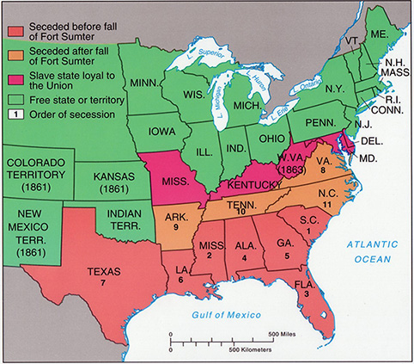

Slide 25
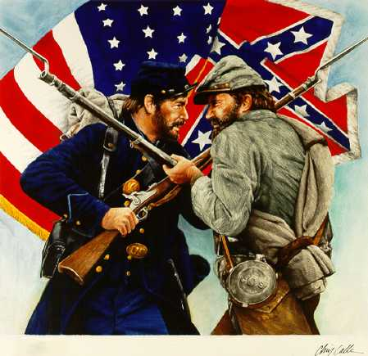
The beginning
The attack on Fort Sumter marked the official beginning to a long and bloody Civil War.

Slide 26
Road to the Civil war
THE INSTITUTION OF SLAVERY
JOHN BROWN, DRED SCOTT CASE, UNCLE TOM’S CABIN
REPRESENTATION (SLAVE/FREE STATES)
WILMOT PROVISO, BLEEDING KANSAS, COMPROMISE OF 1850
ABRAHAM LINCOLN ELECTED PRESIDENT
Republican Party controls government
SOUTHERN STATES SECEDE
South Carolina leads the way
CONFEDERACY ATTACKS FORT SUMTER
Lincoln forced to retaliate

