Slide 1
What is History?

Slide 2
What is History?
THE STUDY OF PAST EVENTS
“History is a pack of lies about events that never happened told by people who weren’t there.” -George Santayana
“History is a myth that men agree to believe” -Napoleon
“Study history, study history. In history lies all the secrets…”
-Winston Churchill

Slide 3
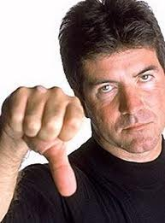
What is History?
History remembers the winners.
Who won the Super Bowl last year(2016/17 season)?
In 50 years, will anybody remember the NY Giants 2016/17 season? (ew)

Slide 4
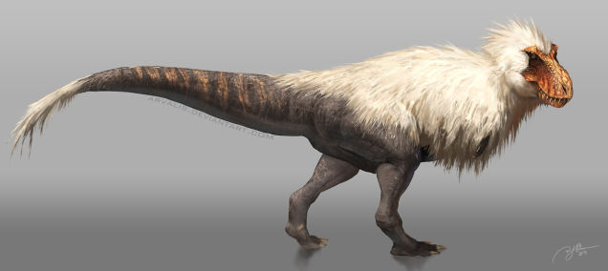
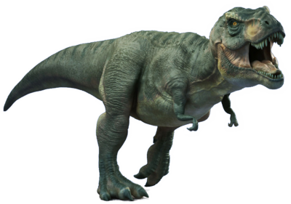
History Changes!
History is changing all the time.
As new information arises our understanding of the past begins to change

Slide 5
Why history?
“If you don’t know history, then you don’t know anything. You are a leaf that doesn’t know it is part of a tree.”
Looking into the past allows us to learn more about ourselves.
“history repeats itself”
Connects us to our origins

Slide 6
How do we learn history?
Primary Sources
Eyewitness accounts, journals, hieroglyphs, pictures
Secondary Sources
Story telling, textbooks
Artifacts
Tools and materials left behind by people
Fossils
Geography
Maps and climate zones

Slide 7
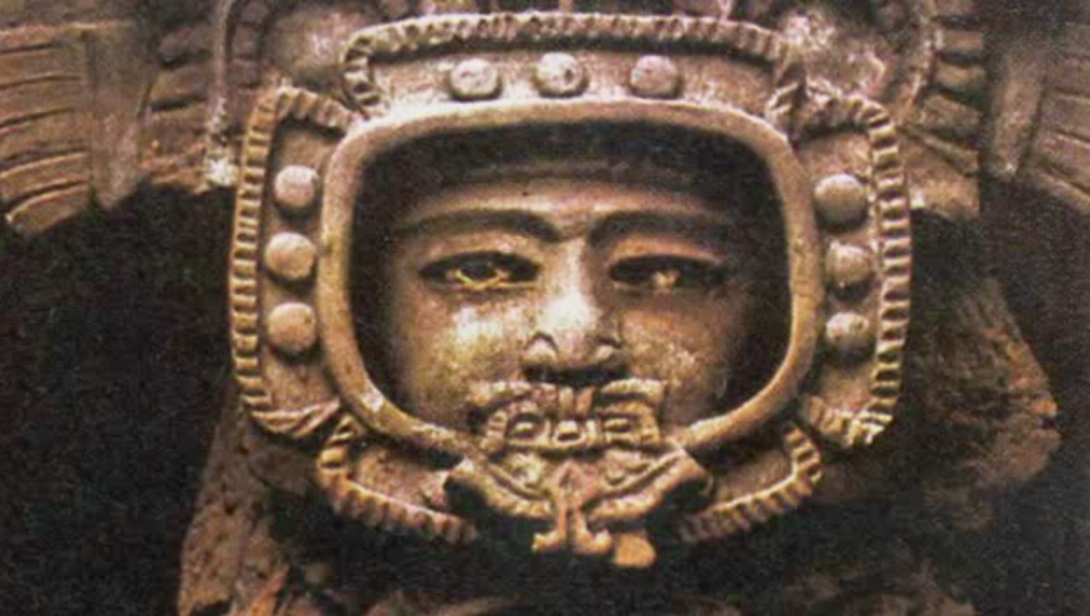
What do you see?

Slide 8
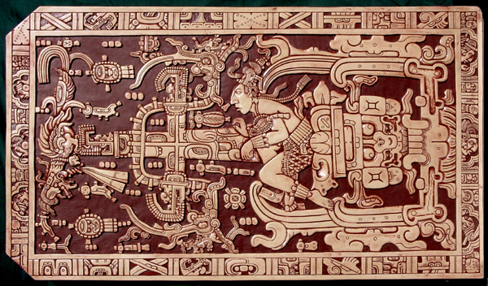
What do you see?

